Slide 1
Recursion

Slide 2
Recursion!
When a method calls itself to solve some problem.
MUST HAVE AN EXIT CONDITION!
Failure to do so will result in a stack overflow exception.

Slide 3
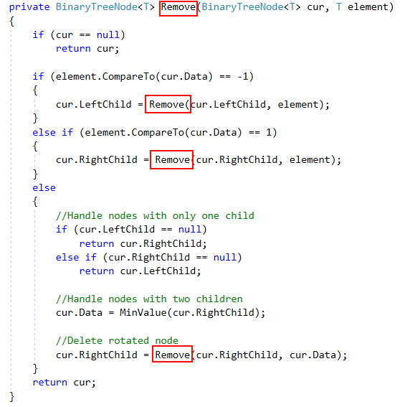

Slide 4
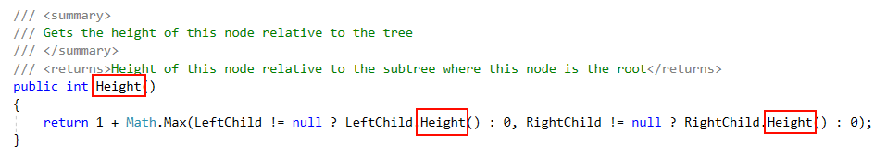

Slide 5
Lab
On canvas there is a zip file containing a fairly interesting folder structure with a single file hidden inside.
Your objective is to use FileIO and Recursion to find the path of the file.
FYI, when I was creating this lab I created almost 10 million folders on my computer… 5 folders 10 layers deep… 5^10
Changing to 3 folders 10 layers deep gives 3^10 which is about 60,000 folders to look through!

